Slide 1
Radhika Ambulkar
data analyst intern duration : 1 August 2024 to 30 September 2024
This is my second internship project at Next24tech Technology and Services. This project deals with the e commerce product recommendation system using data analytics and ML algorithm.
The dataset contains 1465 entries and 16 columns, primarily focused on product information, user reviews, and pricing data. Here's a breakdown of the columns:
product_id: Unique identifier for the product.
product_name: The name of the product.
category: Product categories.
discounted_price: The discounted price of the product.
actual_price: The original price of the product.
discount_percentage: The discount percentage.
rating: The product rating.
rating_count: The number of ratings the product has received.
about_product: Product description or key features.
user_id: The user who reviewed the product.
user_name: Name of users who reviewed the product.
review_id: Review ID associated with each user review.
review_title: Title of the user review.
review_content: Content of the user review.
img_link: Link to the product image.
product_link: Link to the product page.
Step-by-Step Process to Develop the E-Commerce Recommendation System
Data Preprocessing
Convert price columns (discounted_price, actual_price) into numerical values by removing currency symbols.
Handle missing values: Clean columns like rating_count, which may have missing data.

Slide 2
Convert ratings to float.
Create interaction matrix for users and products using
Exploratory Data Analysis (EDA)
Analyze product popularity, ratings, and sales trends.
user_id
and product_id.
Understand user interaction with products based on reviews and ratings.
Recommendation System Approaches
Collaborative Filtering:
Based on user-product interactions (using user_id, product_id, and ratings).
Content-Based Filtering:
Recommend products based on product attributes (like category, about_product).
Model Training
Train the model using algorithms like Matrix Factorization (SVD) or KNN for collaborative filtering.
For content-based, use similarity measures like TF-IDF or Cosine Similarity on the product descriptions.
Evaluation
Use metrics like Precision@K or Recall@K to evaluate the system’s recommendations.
A/B test the recommendations in a real environment to assess performance.
import pandas as pd import numpy as np
import matplotlib.pyplot as plt import seaborn as sns
from sklearn.model_selection import train_test_split from sklearn.metrics.pairwise import cosine_similarity from sklearn.metrics import pairwise_distances
from scipy.sparse import csr_matrix
df = pd.read_csv('amazon.csv') print(df.shape)
print(df.head())
(1465, 16)
product_id 0 B07JW9H4J1
B098NS6PVG
B096MSW6CT
B08HDJ86NZ 4 B08CF3B7N1
product_name \ Wayona Nylon Braided USB to Lightning Fast Cha...
Ambrane Unbreakable 60W / 3A Fast Charging 1.5... Sounce Fast Phone Charging Cable & Data Sync U... boAt Deuce USB 300 2 in 1 Type-C & Micro USB S... Portronics Konnect L 1.2M Fast Charging 3A 8 P...
category discounted_price

Slide 3
 |  | \
 |  | 0 Computers&Accessories|Accessories&Peripherals|... ₹399
 | 1 | Computers&Accessories|Accessories&Peripherals|... | ₹199
 | 2 | Computers&Accessories|Accessories&Peripherals|... | ₹199
 | 3 | Computers&Accessories|Accessories&Peripherals|... | ₹329
 | 4 | Computers&Accessories|Accessories&Peripherals|... | ₹154
actual_price discount_percentage rating rating_count \
0 ₹1,099 64% 4.2 24,269
1 ₹349 43% 4.0 43,994
2 ₹1,899 90% 3.9 7,928
3 ₹699 53% 4.2 94,363
4 ₹399 61% 4.2 16,905
about_product \
High Compatibility : Compatible With iPhone 12...
Compatible with all Type C enabled devices, be...
【 Fast Charger& Data Sync】-With built-in safet...
The boAt Deuce USB 300 2 in 1 cable is compati...
[CHARGE & SYNC FUNCTION]- This cable comes wit...
user_id \
AG3D6O4STAQKAY2UVGEUV46KN35Q,AHMY5CWJMMK5BJRBB...
AECPFYFQVRUWC3KGNLJIOREFP5LQ,AGYYVPDD7YG7FYNBX...
AGU3BBQ2V2DDAMOAKGFAWDDQ6QHA,AESFLDV2PT363T2AQ...
AEWAZDZZJLQUYVOVGBEUKSLXHQ5A,AG5HTSFRRE6NL3M5S...
AE3Q6KSUK5P75D5HFYHCRAOLODSA,AFUGIFH5ZAFXRDSZH...
user_name \
Manav,Adarsh gupta,Sundeep,S.Sayeed Ahmed,jasp...
ArdKn,Nirbhay kumar,Sagar Viswanathan,Asp,Plac...
Kunal,Himanshu,viswanath,sai niharka,saqib mal...
Omkar dhale,JD,HEMALATHA,Ajwadh a.,amar singh ...
rahuls6099,Swasat Borah,Ajay Wadke,Pranali,RVK...
review_id \
R3HXWT0LRP0NMF,R2AJM3LFTLZHFO,R6AQJGUP6P86,R1K...
RGIQEG07R9HS2,R1SMWZQ86XIN8U,R2J3Y1WL29GWDE,RY...
R3J3EQQ9TZI5ZJ,R3E7WBGK7ID0KV,RWU79XKQ6I1QF,R2...
R3EEUZKKK9J36I,R3HJVYCLYOY554,REDECAZ7AMPQC,R1...
R1BP4L2HH9TFUP,R16PVJEXKV6QZS,R2UPDB81N66T4P,R...
review_title \
Satisfied,Charging is really fast,Value for mo...
A Good Braided Cable for Your Type C Device,Go...

Slide 4
2 Good speed for earlier versions,Good Product,W...
3 Good product,Good one,Nice,Really nice product...
4 As good as original,Decent,Good one for second...
review_content \
Looks durable Charging is fine tooNo complains...
I ordered this cable to connect my phone to An...
Not quite durable and sturdy,https://m.media-a...
Good product,long wire,Charges good,Nice,I bou...
Bought this instead of original apple, does th...
img_link \
https://m.media-amazon.com/images/W/WEBP_40237...
https://m.media-amazon.com/images/W/WEBP_40237...
https://m.media-amazon.com/images/W/WEBP_40237...
https://m.media-amazon.com/images/I/41V5FtEWPk...
https://m.media-amazon.com/images/W/WEBP_40237...
product_link
https://www.amazon.in/Wayona-Braided-WN3LG1-Sy...
https://www.amazon.in/Ambrane-Unbreakable-Char...
https://www.amazon.in/Sounce-iPhone-Charging-C...
https://www.amazon.in/Deuce-300-Resistant-Tang...
https://www.amazon.in/Portronics-Konnect-POR-1...
print(df.tail())
product_id product_name \ 1460 B08L7J3T31 Noir Aqua - 5pcs PP Spun Filter + 1 Spanner | ... 1461 B01M6453MB Prestige Delight PRWO Electric Rice Cooker (1 ...
1462 | B009P2LIL4 | Bajaj Majesty RX10 2000 Watts Heat Convector R...
1463 | B00J5DYCCA | Havells Ventil Air DSP 230mm Exhaust Fan (Pist...
1464 | B01486F4G6 | Borosil Jumbo 1000-Watt Grill Sandwich Maker (...
category
discounted_price \
1460 Home&Kitchen|Kitchen&HomeAppliances|WaterPurif...
₹379
1461 Home&Kitchen|Kitchen&HomeAppliances|SmallKitch...
₹2,280
1462 Home&Kitchen|Heating,Cooling&AirQuality|RoomHe...
₹2,219
1463 Home&Kitchen|Heating,Cooling&AirQuality|Fans|E...
₹1,399
1464 Home&Kitchen|Kitchen&HomeAppliances|SmallKitch...
₹2,863
actual_price discount_percentage rating rating_count \ 1460 ₹919 59% 4 1,090
1461 | ₹3,045 | 25% | 4.1 | 4,118

Slide 5
 | 1462 | ₹3,080 | 28% | 3.6 | 468
 | 1463 | ₹1,890 | 26% | 4 | 8,031
 | 1464 | ₹3,690 | 22% | 4.3 | 6,987
1460 | SUPREME QUALITY 90 GRAM 3 LAYER | about_product THIK PP SPUN F... | \
1461 | 230 Volts, | 400 watts, 1 Year
1462 | International design and styling|Two heat sett...
1463 | Fan sweep area: 230 MM ; Noise level: (40 - 45...
1464 | Brand-Borosil, Specification â€“ 23V ~ 5Hz;1 W...
1460 | user_id AHITFY6AHALOFOHOZEOC6XBP4FEA,AFRABBODZJZQB6Z4U... |  | \
1461 | AFG5FM3NEMOL6BNFRV2NK5FNJCHQ,AGEINTRN6Z563RMLH...
1462 | AGVPWCMAHYQWJOQKMUJN4DW3KM5Q,AF4Q3E66MY4SR7YQZ...
1463 | AF2JQCLSCY3QJATWUNNHUSVUPNQQ,AFDMLUXC5LS5RXDJS...
1464 | AFGW5PT3R6ZAVQR4Y5MWVAKBZAYA,AG7QNJ2SCS5VS5VYY...
1460 | user_name Prabha ds,Raghuram bk,Real Deal,Amazon Custome... |  | \
1461 | Manu Bhai,Naveenpittu,Evatira Sangma,JAGANNADH...
1462 | Nehal Desai,Danish Parwez,Amazon Customer,Amaz...
1463 | Shubham Dubey,E.GURUBARAN,Mayank S.,eusuf khan...
1464 | Rajib,Ajay B,Vikas Kahol,PARDEEP,Anindya Prama...
1460 | review_id R3G3XFHPBFF0E8,R3C0BZCD32EIGW,R2EBVBCN9QPD9R,R... |  | \
1461 | R3DDL2UPKQ2CK9,R2SYYU1OATVIU5,R1VM993161IYRW,R...
1462 | R1TLRJVW4STY5I,R2O455KRN493R1,R3Q5MVGBRIAS2G,R...
1463 | R39Q2Y79MM9SWK,R3079BG1NIH6MB,R29A31ZELTZNJM,R...
1464 | R20RBRZ0WEUJT9,ROKIFK9R2ISSE,R30EEG2FNJSN5I,R2...
1460 | review_title Received the product without spanner,Excellent... |  | \
1461 | ok,everything was good couldn't return bcoz I ...
1462 | very good,Work but front melt after 2 month,Go...
1463 | Fan Speed is slow,Good quality,Good product,go...
1464 | Works perfect,Ok good product,Nice Product. Re...
1460 | review_content I received product without spanner,Excellent p... |  | \
1461 | ok,got everything as mentioned but the measuri...
1462 | plastic but cool body ,u have to find sturdy s...
1463 | I have installed this in my kitchen working fi...
1464 | It does it job perfectly..only issue is temp c...
1460 | img_link https://m.media-amazon.com/images/I/41fDdRtjfx... |  | \
1461 | https://m.media-amazon.com/images/I/41gzDxk4+k...
1462 | https://m.media-amazon.com/images/W/WEBP_40237...

Slide 6
 | 1463 | https://m.media-amazon.com/images/W/WEBP_40237...
 | 1464 | https://m.media-amazon.com/images/W/WEBP_40237...
 | 1460 | product_link https://www.amazon.in/Noir-Aqua-Spanner-Purifi...
 | 1461 | https://www.amazon.in/Prestige-Delight-PRWO-1-...
 | 1462 | https://www.amazon.in/Bajaj-RX-10-2000-Watt-Co...
 | 1463 | https://www.amazon.in/Havells-Ventilair-230mm-...
 | 1464 | https://www.amazon.in/Borosil-Jumbo-1000-Watt-...
print(df.describe())
product_id
\
count 1465
product_name
1465
unique 1351 1337
top B07JW9H4J1 Fire-Boltt Ninja Call Pro Plus 1.83" Smart Wat...
freq 3 5
discounted_price \ count
1465
unique 550
category
1465
211
top
₹199
freq 53
Computers&Accessories|Accessories&Peripherals|...
233
actual_price discount_percentage rating rating_count \ count 1465 1465 1465 1463
unique | 449 | 92 | 28 | 1143
top | ₹999 | 50% | 4.1 | 9,378
freq | 120 | 56 | 244 | 9
count unique top freq
about_product \
1465
1293
[CHARGE & SYNC FUNCTION]- This cable comes wit...
6
 | user_id | \
count | 1465
unique | 1194
top | AHIKJUDTVJ4T6DV6IUGFYZ5LXMPA,AE55KTFVNXYFD5FPY...
freq | 10

Slide 7
 | user_name | \
count | 1465
unique | 1194
top | $@|\|TO$|-|,Sethu madhav,Akash Thakur,Burger P...
freq | 10
 | review_id | \
count | 1465
unique | 1194
top | R3F4T5TRYPTMIG,R3DQIEC603E7AY,R1O4Z15FD40PV5,R...
freq | 10
 | review_title | \
count | 1465
unique | 1194
top | Worked on iPhone 7 and didn’t work on XR,Good ...
freq | 10
 | review_content | \
count | 1465
unique | 1212
top | I am not big on camera usage, personally. I wa...
freq | 8
 | img_link | \
count | 1465
unique | 1412
top | https://m.media-amazon.com/images/I/413sCRKobN...
freq | 3
 | product_link
count | 1465
unique | 1465
top | https://www.amazon.in/Wayona-Braided-WN3LG1-Sy...
freq | 1
print(df.info())
<class 'pandas.core.frame.DataFrame'> RangeIndex: 1465 entries, 0 to 1464 Data columns (total 16 columns):
# Column Non-Null Count
Dtype
0 product_id | 1465 | non-null |  | object
1 product_name | 1465 | non-null |  | object
2 category | 1465 | non-null |  | object
3 discounted_price | 1465 | non-null |  | object
4 actual_price | 1465 | non-null |  | object
5 discount_percentage | 1465 | non-null |  | object

Slide 8
 | 6 | rating | 1465 | non-null | object
 | 7 | rating_count | 1463 | non-null | object
 | 8 | about_product | 1465 | non-null | object
 | 9 | user_id | 1465 | non-null | object
 | 10 | user_name | 1465 | non-null | object
 | 11 | review_id | 1465 | non-null | object
 | 12 | review_title | 1465 | non-null | object
 | 13 | review_content | 1465 | non-null | object
 | 14 | img_link | 1465 | non-null | object
 | 15 | product_link | 1465 | non-null | object
dtypes: object(16) memory usage: 183.3+ KB
None
print("No of null values :\n",df.isnull().sum()) hdata = df.dropna()
print("No of null values after removing :\n",df.isnull().sum())
No of null values :
product_id
0
product_name category discounted_price actual_price discount_percentage rating
rating_count about_product user_id user_name review_id review_title review_content img_link product_link
0
0
0
0
0
0
2
0
0
0
0
0
0
0
0
dtype: int64
No of null values after removing : product_id 0
product_name | 0
category | 0
discounted_price | 0
actual_price | 0
discount_percentage | 0
rating | 0
rating_count | 2
about_product | 0
user_id | 0
user_name | 0
review_id | 0
review_title | 0

Slide 9
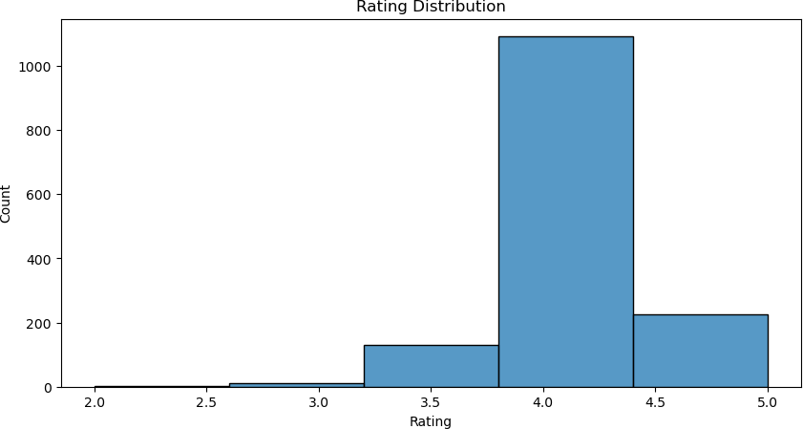
review_content img_link product_link dtype: int64
0
0
0
plt.figure(figsize=(10, 5)) sns.histplot(df['rating'], bins=5, kde=False) plt.title('Rating Distribution') plt.xlabel('Rating')
plt.ylabel('Count') plt.show()
plt.figure(figsize=(8, 6)) sns.histplot(df['rating'], bins=20, kde=True) plt.title('Distribution of Product Ratings') plt.xlabel('Rating')
plt.ylabel('Frequency') plt.show()

Slide 10
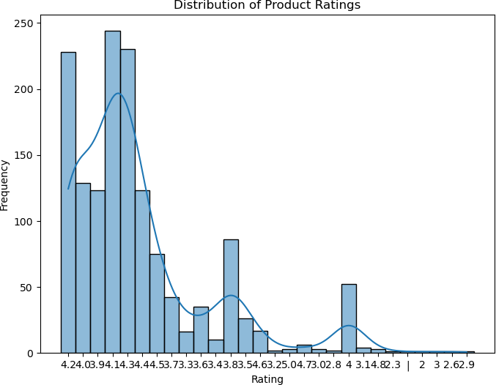
plt.figure(figsize=(10, 8)) df['category'].value_counts().head(10).plot(kind='bar') plt.title('Top 10 Product Categories') plt.xlabel('Number of Products')
plt.ylabel('Category') plt.show()

Slide 11
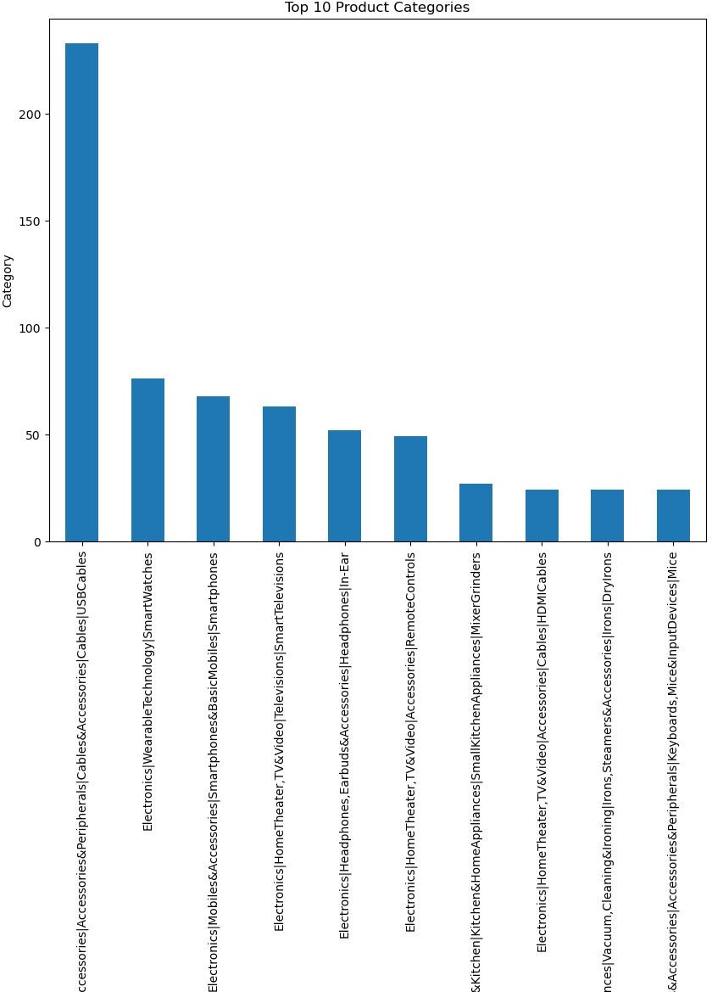

Slide 12
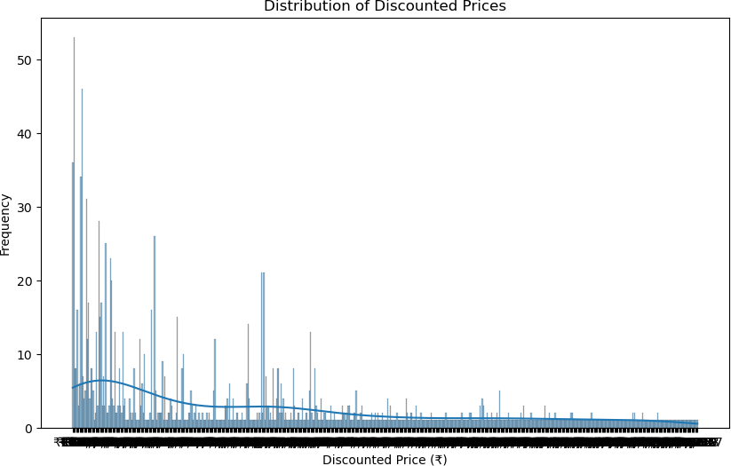
# Distribution of Discounted Prices plt.figure(figsize=(10, 6)) sns.histplot(df['discounted_price'], bins=30, kde=True) plt.title('Distribution of Discounted Prices') plt.xlabel('Discounted Price (₹)') plt.ylabel('Frequency')
plt.show()
# Distribution of Actual Prices plt.figure(figsize=(10, 6)) sns.histplot(df['actual_price'], bins=30, kde=True) plt.title('Distribution of Actual Prices') plt.xlabel('Actual Price (₹)') plt.ylabel('Frequency')
plt.show()

Slide 13
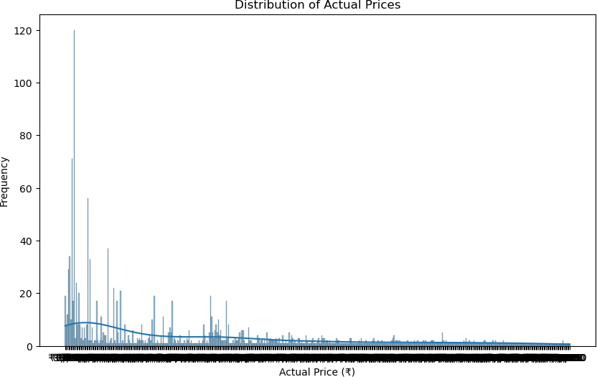
# Convert discount_percentage to numeric after removing the '%' df['discount_percentage'] = df['discount_percentage'].replace({'%': ''}, regex=True).astype(float)
# Distribution of Discount Percentages plt.figure(figsize=(10, 6)) sns.histplot(df['discount_percentage'], bins=20, kde=True) plt.title('Distribution of Discount Percentages') plt.xlabel('Discount Percentage (%)') plt.ylabel('Frequency')
plt.show()
# Average discount by product category
category_discount = df.groupby('category') ['discount_percentage'].mean().sort_values(ascending=False) plt.figure(figsize=(12, 8)) category_discount.head(10).plot(kind='bar', color='green') plt.title('Top 10 Categories by Average Discount Percentage') plt.xlabel('Average Discount Percentage (%)') plt.ylabel('Category')
plt.show()

Slide 14
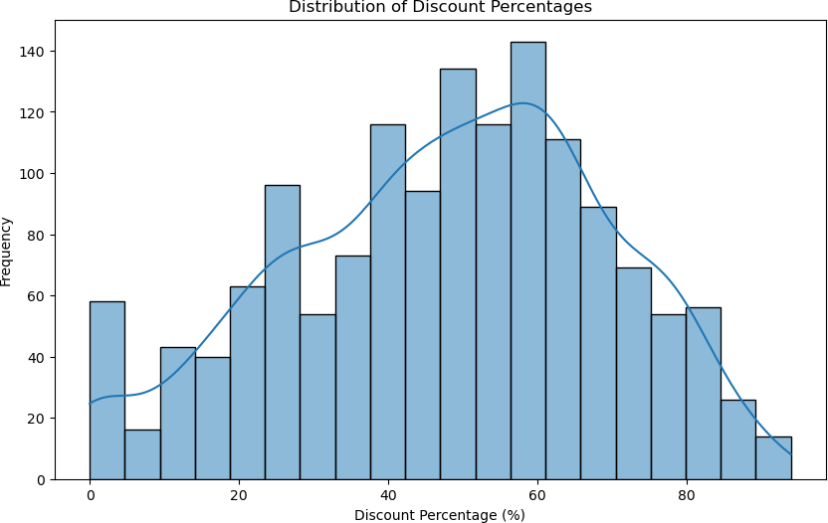

Slide 15
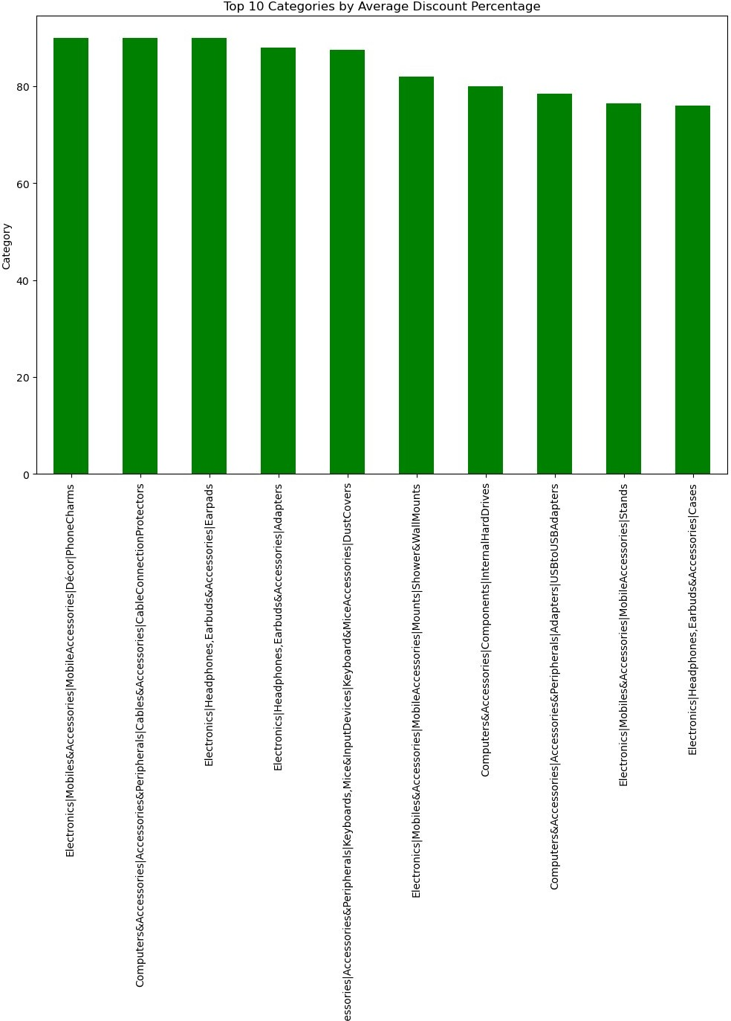

Slide 16
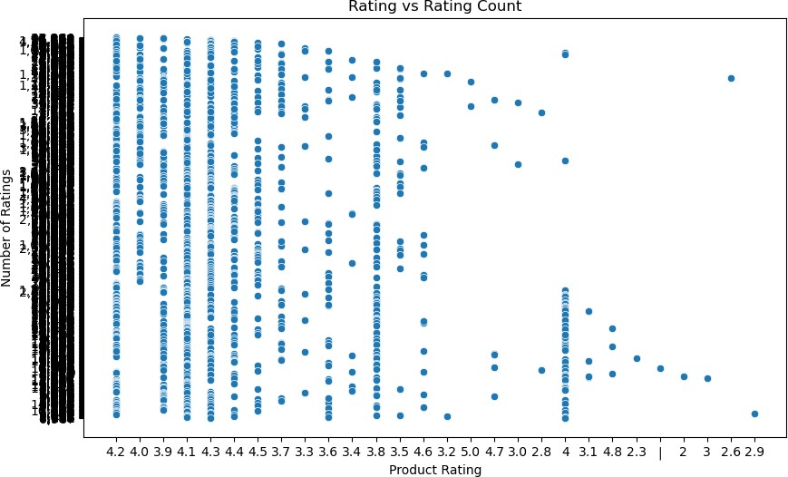
# Scatter plot: Rating vs Rating Count plt.figure(figsize=(10, 6)) sns.scatterplot(x='rating', y='rating_count', data=df) plt.title('Rating vs Rating Count') plt.xlabel('Product Rating')
plt.ylabel('Number of Ratings') plt.show()
# Number of reviews per user
reviews_per_user = df.groupby('user_id')['review_id'].count() plt.figure(figsize=(10, 6))
sns.histplot(reviews_per_user, bins=30, kde=True) plt.title('Distribution of Reviews per User') plt.xlabel('Number of Reviews') plt.ylabel('Frequency')
plt.show()
# Top users by the number of reviews
top_users = reviews_per_user.sort_values(ascending=False).head(10) plt.figure(figsize=(10, 6))
top_users.plot(kind='barh', color='purple') plt.title('Top 10 Users by Number of Reviews') plt.xlabel('Number of Reviews') plt.ylabel('User ID')
plt.show()

Slide 17
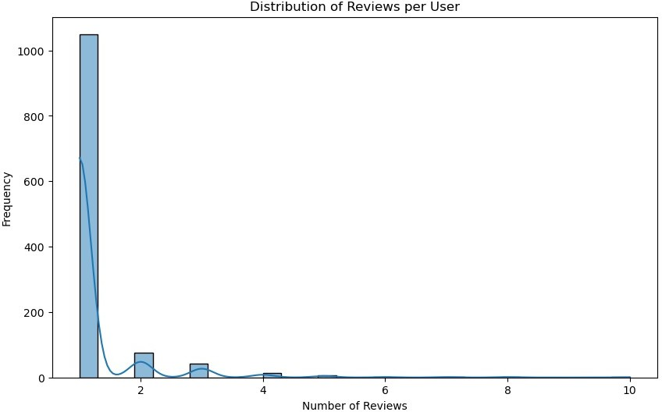
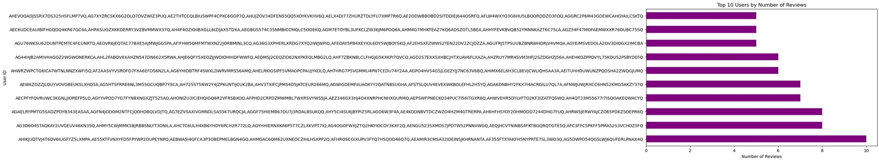
# Count of products per category
plt.figure(figsize=(10, 6)) df['category'].value_counts().head(10).plot(kind='barh', color='orange')
plt.title('Top 10 Categories by Number of Products') plt.xlabel('Number of Products') plt.ylabel('Category')
plt.show()

Slide 18
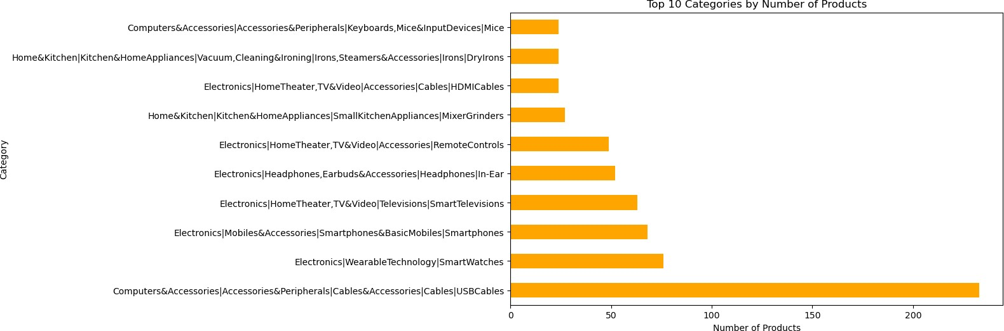
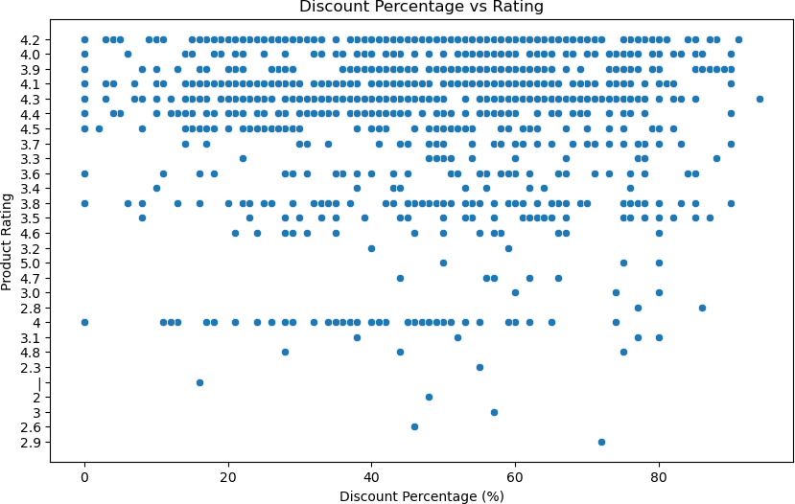
# Scatter plot: Discount Percentage vs Rating plt.figure(figsize=(10, 6)) sns.scatterplot(x='discount_percentage', y='rating', data=df) plt.title('Discount Percentage vs Rating') plt.xlabel('Discount Percentage (%)')
plt.ylabel('Product Rating') plt.show()
# Check the unique values in price-related columns before conversion
print("Unique values in 'discounted_price' before conversion:")

Slide 19
print(df['discounted_price'].unique())
print("Unique values in 'actual_price' before conversion:") print(df['actual_price'].unique())
# Now, perform the conversion
df['discounted_price'] = df['discounted_price'].replace({'₹': '', ',': ''}, regex=True).astype(float)
df['actual_price'] = df['actual_price'].replace({'₹': '', ',': ''}, regex=True).astype(float)
# Check for unique values in rating_count and rating before conversion print("Unique values in 'rating_count' before conversion:") print(df['rating_count'].unique())
print("Unique values in 'rating' before conversion:") print(df['rating'].unique())
# Replace commas and N/A values in rating_count and rating df['rating_count'] = df['rating_count'].replace({',': ''}, regex=True).astype(float)
# Check the data type of the 'rating' column
print("Data type of 'rating':", df['rating'].dtype)
# Print unique values to inspect the actual entries in the 'rating' column
print("Unique values in 'rating' before replacement:") print(df['rating'].unique())
# Check for any remaining NaN values
print("Missing values in 'rating':", df['rating'].isnull().sum()) print("Missing values in 'rating_count':", df['rating_count'].isnull().sum())
# Drop rows where rating or rating_count are missing
df = df.dropna(subset=['rating', 'rating_count'])
# Final check after data cleaning print("Data after cleaning:") df.info()
Unique values in 'discounted_price' before conversion:
[3.99000e+02 1.99000e+02 3.29000e+02 1.54000e+02 1.49000e+02
1.76630e+02
2.29000e+02 4.99000e+02 2.99000e+02 2.19000e+02 3.50000e+02
1.59000e+02
3.49000e+02 1.39990e+04 2.49000e+02 1.34900e+04 9.70000e+02
2.79000e+02
5.90000e+01 1.14990e+04 1.49990e+04 1.79000e+02 3.89000e+02

Slide 20
5.99000e+02
9.90000e+01 8.99000e+02 3.29990e+04 2.09000e+02 1.99990e+04
9.99000e+02
3.33000e+02 5.07000e+02 3.09000e+02 1.19900e+03 7.99000e+02
6.99900e+03
2.30000e+02 6.49000e+02 1.59990e+04 3.48000e+02 3.29900e+04
1.39000e+02
2.63000e+02 7.99900e+03 1.59900e+03 2.69990e+04 1.15000e+02
1.09010e+04
1.43400e+03 7.29900e+03 3.25000e+02 2.99990e+04 2.79990e+04
3.09900e+04
2.69000e+02 2.49990e+04 1.89900e+04 2.90000e+02 3.45000e+02
1.09900e+03
7.19000e+02 8.49000e+02 2.19990e+04 4.49000e+02 3.79990e+04
7.39000e+03
2.73100e+02 1.59900e+04 2.10000e+02 1.29900e+03 3.47000e+02
2.28000e+02
1.49900e+03 8.49900e+03 2.09900e+04 9.99900e+03 4.89000e+02
2.39990e+04
6.89000e+02 1.69900e+03 6.55000e+02 7.49000e+02 1.95000e+02
4.16000e+02
3.68000e+02 2.99900e+04 3.39000e+02 1.54900e+04 9.49000e+03
6.37000e+02
1.08900e+03 1.24990e+04 1.39900e+03 8.80000e+01 5.78900e+01
2.05000e+02
9.49000e+02 3.79000e+02 8.99000e+03 4.86000e+02 5.69900e+03
7.09000e+02
4.79900e+04 3.20000e+02 1.29000e+02 2.25000e+02 5.47000e+02
2.59000e+02
2.39000e+02 4.67000e+02 1.19900e+04 2.52000e+02 2.04000e+02
6.49000e+03
2.35000e+02 4.29990e+04 1.73000e+02 8.48990e+02 1.24900e+03
2.13000e+02
5.98000e+02 3.19990e+04 1.28310e+02 2.54000e+02 8.90000e+01
5.49000e+02
7.79900e+04 1.82000e+02 9.60000e+01 5.49900e+04 4.39000e+02
7.89000e+02
7.90000e+02 4.69900e+03 1.89990e+04 1.99000e+03 2.29900e+03
3.59990e+04
8.99900e+03 9.17000e+02 4.59990e+04 1.19000e+02 2.19900e+04
4.17440e+02
2.15000e+02 1.28900e+03 6.09000e+02 1.85000e+03 1.39900e+04
1.85000e+02
2.18000e+02 8.93000e+02 1.09900e+04 1.69990e+04 6.99000e+02
2.69900e+03
2.46000e+02 2.47000e+02 1.36900e+03 2.49900e+04 6.19990e+04
2.44990e+04
1.04990e+04 1.97000e+02 1.51900e+03 4.69990e+04 1.79900e+03
1.99800e+03

Slide 21
1.99900e+03 2.04900e+03 6.49900e+03 2.89990e+04 5.69000e+02
1.89800e+03
9.49900e+03 9.59000e+02 1.14900e+03 1.21900e+03 1.84990e+04
3.69000e+02
1.29990e+04 2.19900e+03 1.64990e+04 3.99900e+03 2.99800e+03
1.54990e+04
8.73000e+02 5.39000e+02 1.07500e+03 5.29000e+02 4.79000e+03
3.39990e+04
1.09990e+04 3.49990e+04 2.99900e+03 2.09990e+04 2.29990e+04
1.34000e+02
7.49900e+03 1.32400e+03 1.24900e+04 1.79990e+04 2.09900e+03
3.37000e+02
2.51000e+02 9.50000e+01 4.49900e+03 1.98900e+03 4.99900e+03
2.49900e+03
7.90000e+01 2.17900e+03 4.49990e+04 2.59900e+03 2.79900e+03
3.79900e+03
2.81000e+02 7.99800e+03 1.20000e+02 7.91500e+03 1.05500e+03
1.50000e+02
4.74000e+02 2.65000e+02 3.79900e+04 3.14000e+02 3.65000e+02
2.89000e+02
2.17000e+02 1.22000e+03 4.75000e+02 7.98000e+02 2.66000e+02
5.00000e+01
1.30000e+02 4.09800e+03 5.19000e+02 1.29500e+03 1.88900e+03
4.55000e+02
1.05900e+03 7.17000e+02 3.90000e+01 8.89000e+02 1.91000e+02
5.22000e+02
6.81000e+02 4.29000e+02 1.00000e+02 1.04900e+03 6.56000e+02
1.10900e+03
1.69000e+02 1.57000e+02 4.79000e+02 1.59800e+03 2.94000e+02
8.28000e+02
7.45000e+02 1.54900e+03 1.46900e+03 1.98000e+02 1.20000e+04
6.29900e+03
5.71000e+02 4.48000e+02 5.79000e+02 1.37000e+02 1.49500e+03
4.40000e+02
1.32900e+03 5.70000e+02 1.52900e+03 1.90000e+02 7.29000e+02
4.80000e+02
2.38000e+02 1.34900e+03 1.79200e+03 3.29900e+03 1.25000e+02
5.61000e+02
5.59900e+03 6.90000e+01 4.78000e+02 4.25000e+02 3.78000e+02
1.81500e+03
6.70000e+01 5.79900e+03 4.44900e+03 6.29000e+02 2.59500e+03
9.00000e+01
1.34500e+03 2.87000e+02 8.79000e+02 2.50000e+02 4.69000e+02
1.18700e+03
3.28000e+02 1.14000e+02 1.49000e+03 5.75000e+02 1.78000e+02
9.39000e+02
1.43900e+03 1.75000e+02 3.30300e+03 1.89000e+03 3.10000e+02
1.70900e+03
2.02500e+03 9.00000e+02 2.49000e+03 1.16000e+02 2.00000e+02

Slide 22
2.64900e+03
5.96000e+02 3.30000e+02 1.23400e+03 2.72000e+02 3.49800e+03
1.00990e+04
3.97000e+02 1.67900e+03 3.54000e+02 1.03890e+04 1.40900e+03
5.99800e+03
3.00000e+02 5.35000e+02 3.41000e+02 5.89900e+03 1.56500e+03
3.26000e+02
6.57000e+02 1.99500e+03 1.50000e+03 2.64000e+03 5.29900e+03
1.65000e+02
3.98000e+02 7.70000e+02 4.20000e+02 8.34900e+03 3.30700e+03
3.80000e+02
3.72470e+04 2.98000e+02 2.93000e+02 1.04300e+03 1.46400e+03
6.25000e+02
1.29000e+03 3.60000e+03 6.54900e+03 1.62500e+03 5.49900e+03
2.14800e+03
3.59900e+03 3.51000e+02 1.61400e+03 6.78000e+02 8.09000e+02
1.96900e+03
1.66500e+03 3.22900e+03 1.26000e+03 3.49900e+03 1.32100e+03
7.75000e+02
3.19000e+03 6.19900e+03 1.81900e+03 3.24900e+03 1.40000e+03
3.55000e+02
2.16900e+03 6.53000e+02 4.78900e+03 7.53000e+02 3.53000e+02
8.79900e+03
2.09500e+03 1.49800e+03 3.69900e+03 1.77000e+02 2.44000e+02
1.95900e+03
3.19000e+02 9.59000e+03 2.92000e+02 1.60000e+02 6.00000e+02
1.13000e+03
3.19900e+03 6.16000e+02 6.10000e+02 4.53000e+02 2.46400e+03
2.71900e+03
2.08800e+03 2.39900e+03 3.08000e+02 2.45000e+02 3.56900e+03
2.08900e+03
2.33900e+03 7.84000e+02 1.69500e+03 1.44800e+03 6.99000e+03
2.69800e+03
1.41400e+03 5.99900e+03 9.97000e+03 6.98000e+02 1.44000e+04
6.64000e+02
2.60000e+02 1.48400e+03 4.28000e+03 1.89000e+02 1.44900e+03
3.65766e+03
1.84900e+03 8.19900e+03 1.59500e+03 1.18200e+03 1.05200e+03
1.54700e+03
5.10000e+02 1.89900e+03 1.44990e+04 9.50000e+02 7.19900e+03
2.43900e+03
7.79900e+03 2.89900e+03 9.79900e+03 6.69000e+02 5.89000e+03
9.19900e+03
6.23600e+03 2.74200e+03 7.21000e+02 2.90300e+03 1.65600e+03
2.07900e+03
3.17900e+03 4.79900e+03 9.48000e+02 8.50000e+02 3.71100e+03
9.80000e+02
3.34900e+03 2.24900e+03 1.23500e+03 6.80000e+03 1.06900e+03
2.09200e+03

Slide 23
3.85900e+03 1.80400e+03 6.52500e+03 1.18900e+03 2.59000e+03
9.98000e+02
9.98060e+02 8.88600e+03 4.99500e+03 3.95000e+02 6.35000e+02
2.79000e+04
1.93000e+02 2.44900e+03 2.28600e+03 5.39500e+03 5.59000e+02
6.60000e+02
4.19000e+02 7.34900e+03 1.47400e+03 3.64500e+03 3.75000e+02
2.97600e+03
2.57500e+03 1.64900e+03 7.65000e+02 5.87000e+02 1.26090e+04
6.40000e+02
9.79000e+02 5.36500e+03 9.29000e+02 3.71000e+03 2.03300e+03
9.49500e+03
2.79000e+03 6.45000e+02 2.23781e+03 8.69900e+03 4.29900e+04
8.25000e+02
1.61000e+02 6.97000e+02 6.88000e+02 6.85000e+03 1.09000e+03
2.95000e+02
2.94900e+03 3.35000e+02 7.78000e+02 1.19000e+03 6.12000e+03
3.68500e+03
8.59900e+03 1.11000e+03 7.59000e+02 2.66900e+03 8.50000e+01
5.86500e+03
1.92800e+03 1.45600e+03 4.89900e+03 3.29000e+03 5.49000e+03
3.04167e+03
1.74500e+03 3.18000e+03 3.90000e+02 1.62400e+03 1.84000e+02
4.45000e+02
1.60100e+03 2.31000e+02 6.79000e+03 1.98284e+03 1.18000e+03
2.53000e+02
4.57000e+02 4.26000e+02 2.32000e+03 1.56300e+03 3.48777e+03
4.98000e+02
2.69500e+03 2.28000e+03 2.21900e+03 2.86300e+03]
Unique values in 'actual_price' before conversion: [1.09900e+03 3.49000e+02 1.89900e+03 6.99000e+02 3.99000e+02 1.00000e+03
4.99000e+02 2.99000e+02 9.99000e+02 3.39000e+02 7.99000e+02
7.00000e+02
8.99000e+02 2.49990e+04 2.19900e+04 1.79900e+03 2.29000e+04
1.99000e+02
1.99900e+04 1.99990e+04 1.99900e+03 7.50000e+02 5.99000e+02
6.66660e+02
1.90000e+03 4.59990e+04 6.95000e+02 3.49990e+04 1.59900e+03
1.20800e+03
4.75000e+02 3.95000e+02 2.19900e+03 5.00000e+02 2.10000e+03
1.29990e+04
1.39900e+03 2.19990e+04 1.49900e+03 4.79000e+04 8.45000e+02
1.40000e+03
1.49900e+04 2.99900e+03 4.29990e+04 3.09900e+04 3.99900e+03
2.49000e+02
1.91250e+04 1.29900e+03 3.99990e+04 4.09900e+04 5.29000e+04
8.00000e+02
3.19990e+04 1.80900e+03 2.99990e+04 6.50000e+04 2.00000e+04

Slide 24
2.39900e+04
1.59990e+04 4.49900e+04 4.49990e+04 1.70000e+03 5.95000e+02
2.79900e+04
1.20000e+03 3.49900e+04 1.50000e+03 4.99900e+04 9.31000e+02
2.39900e+03
1.33900e+03 2.09000e+04 1.59900e+04 1.60000e+03 8.49000e+02
1.19900e+03
2.29900e+04 2.49900e+03 4.79900e+04 4.85000e+02 1.89900e+04
1.10000e+04
7.09000e+04 5.49000e+02 3.59990e+04 1.69900e+03 3.19900e+04
9.99000e+03
1.69900e+04 5.99990e+04 6.00000e+02 1.49000e+03 2.29900e+03
4.99900e+03
1.74900e+03 1.10000e+03 4.99990e+04 5.67900e+04 7.95000e+02
7.98000e+02
9.95000e+02 1.39900e+05 8.50000e+04 7.58000e+02 4.69900e+03
2.49900e+04
6.50000e+02 3.10000e+03 1.89990e+04 6.99000e+04 6.70000e+02
7.99900e+04
3.50000e+04 5.49900e+04 5.09990e+04 4.50000e+03 2.89000e+04
4.49000e+02
9.00000e+02 1.05200e+03 2.59990e+04 3.50000e+03 1.49990e+04
5.19900e+04
6.99990e+04 5.00000e+04 1.94990e+04 9.99900e+03 7.99000e+03
8.99900e+03
2.89990e+04 6.99000e+03 1.19990e+04 1.80000e+03 7.99900e+03
1.79990e+04
2.09990e+04 1.09990e+04 8.49900e+03 4.95000e+02 1.69990e+04
5.99900e+03
2.09900e+04 3.99000e+03 3.39990e+04 3.89990e+04 2.69990e+04
6.49000e+02
1.71000e+02 2.89900e+03 2.99900e+04 1.63000e+03 1.34990e+04
6.99900e+03
6.49900e+03 2.99000e+03 2.40000e+03 1.49000e+02 5.29900e+03
3.29990e+04
3.99900e+04 3.49900e+03 2.59900e+03 1.24900e+03 9.49900e+03
7.49990e+04
4.49000e+03 8.95000e+02 2.37000e+02 1.99500e+03 3.15000e+02
5.00000e+01
1.65000e+02 1.29000e+03 2.49800e+03 5.49900e+03 1.35000e+03
1.29500e+03
7.61000e+02 2.50000e+03 1.80000e+02 2.25000e+02 4.49900e+03
5.50000e+02
3.49000e+03 2.50000e+02 2.80000e+03 4.04000e+02 1.60000e+02
3.00000e+03
8.61000e+02 2.49500e+03 1.37500e+04 5.90000e+01 3.29900e+03
3.75000e+02
4.40000e+02 2.00000e+03 2.90000e+03 1.00000e+02 1.79500e+03
2.20000e+02

Slide 25
1.65000e+03 2.19800e+03 4.10000e+03 1.19000e+03 9.90000e+01
3.49500e+03
7.20000e+02 5.90000e+02 7.35000e+03 2.59500e+03 2.49000e+03
4.99000e+03
7.50000e+01 2.69900e+03 5.73400e+03 1.39000e+03 3.29500e+03
2.91100e+03
1.75000e+02 3.25000e+03 2.29500e+03 4.50000e+02 1.10900e+03
1.92900e+03
4.00000e+02 1.20000e+02 2.79900e+03 2.10000e+02 2.89000e+03
4.70000e+03
4.33296e+03 9.90000e+02 5.49000e+03 2.79000e+03 1.64500e+03
3.10000e+02
4.19900e+03 4.00000e+03 2.00000e+02 2.30000e+02 2.79600e+03
7.23000e+02
1.24990e+04 3.20000e+02 3.87500e+03 1.91100e+04 1.50000e+02
7.75000e+02
3.20000e+04 1.30000e+03 3.00000e+02 5.35000e+02 7.00500e+03
2.89500e+03
3.19500e+03 6.35500e+03 7.50000e+03 3.90000e+01 3.79990e+04
1.99000e+03
1.94900e+03 1.54700e+03 1.15000e+03 1.09000e+03 3.59900e+03
4.20000e+02
9.62500e+03 6.10000e+03 5.98900e+04 1.24500e+03 1.69500e+03
1.54900e+03
1.44500e+03 3.19300e+03 1.34500e+03 6.19000e+03 1.39990e+04
2.99500e+03
5.89000e+03 1.31500e+04 7.85000e+02 3.21000e+03 1.59500e+03
3.64500e+03
7.95000e+03 1.74500e+03 1.54500e+03 5.00000e+03 3.94500e+03
2.09900e+03
5.29500e+03 3.59500e+03 1.12900e+03 5.79500e+03 8.75000e+02
1.52700e+04
4.19500e+03 1.98900e+03 1.11100e+03 1.04000e+04 6.29500e+03
9.65000e+03
1.05900e+04 8.90000e+01 2.48500e+03 3.27900e+03 3.79900e+03
7.29900e+03
6.25000e+02 1.02000e+03 8.99000e+03 1.63900e+03 1.15950e+04
1.75000e+03
2.09500e+03 2.30000e+03 4.29500e+03 7.49000e+02 1.77500e+03
1.13000e+03
9.45500e+03 8.25000e+02 9.99500e+03 6.00000e+03 5.55000e+03
4.59000e+03
4.40000e+03 5.19000e+03 9.40000e+02 7.90000e+01 1.42900e+04
1.95000e+03
3.19000e+03 2.66000e+03 5.99000e+04 6.37500e+03 3.50000e+02
8.50000e+03
1.56000e+03 6.50000e+03 7.79500e+03 5.99500e+03 2.34900e+03
4.77500e+03
1.23000e+03 5.15600e+03 1.98250e+04 1.92000e+03 1.60000e+04

Slide 26
1.19950e+04
1.69000e+03 1.79000e+03 8.99500e+03 2.39000e+02 4.29000e+03
6.40000e+02
3.79000e+03 4.56000e+03 2.60000e+03 3.30000e+03 2.35590e+04
2.54500e+03
5.50000e+03 1.21500e+04 4.99500e+03 7.50600e+03 1.80000e+04
1.85000e+03
3.99500e+03 2.69500e+03 2.29000e+03 3.09900e+03 1.07500e+03
7.29000e+03
3.39800e+03 1.62000e+03 4.49500e+03 9.80000e+02 1.15000e+04
3.55000e+03
1.97500e+03 4.60000e+03 1.02950e+04 2.38000e+03 8.82000e+03
4.20000e+03
1.28200e+03 1.18500e+04 2.00490e+04 2.48500e+04 1.64900e+04
9.75000e+02
6.35000e+02 3.39000e+03 1.01000e+03 1.09000e+04 4.00500e+03
4.65000e+03
2.45000e+04 6.07000e+03 6.70000e+03 9.70000e+02 2.39990e+04
8.50000e+02
7.44500e+03 1.39500e+03 4.33000e+03 1.25000e+04 2.38500e+03
4.89000e+03
3.89900e+03 1.68990e+04 7.59900e+04 7.47000e+02 1.19900e+04
4.84900e+03
5.10000e+02 2.55000e+03 8.47800e+03 3.89500e+03 5.49500e+03
3.19900e+03
7.77600e+03 2.59000e+03 6.29900e+03 4.79900e+03 5.79900e+03
7.20000e+03
3.89000e+02 1.30490e+04 3.89000e+03 2.60000e+02 8.07300e+03
2.36000e+03
1.14950e+04 4.78000e+03 1.09950e+04 1.44000e+03 3.04500e+03
3.29000e+03
3.09800e+03 9.19000e+02 3.08000e+03 1.89000e+03 3.69000e+03]
Unique values in 'rating_count' before conversion: [24269. 43994. 7928. ... 468. 8031. 6987.]
Unique values in 'rating' before conversion:
['4.2' '4.0' '3.9' '4.1' '4.3' '4.4' '4.5' '3.7' '3.3' '3.6' '3.4'
'3.8'
'3.5' '4.6' '3.2' '5.0' '4.7' '3.0' '2.8' '4' '3.1' '4.8' '2.3' '|'
'2'
'3' '2.6' '2.9']
Data type of 'rating': object
Unique values in 'rating' before replacement:
['4.2' '4.0' '3.9' '4.1' '4.3' '4.4' '4.5' '3.7' '3.3' '3.6' '3.4'
'3.8'
'3.5' '4.6' '3.2' '5.0' '4.7' '3.0' '2.8' '4' '3.1' '4.8' '2.3' '|'
'2'
'3' '2.6' '2.9']
Missing values in 'rating': 0 Missing values in 'rating_count': 2

Slide 27
Data after cleaning:
<class 'pandas.core.frame.DataFrame'>
Index: 1463 entries, 0 to 1464
Data columns (total 16 columns):
# Column Non-Null Count Dtype
product_id
product_name
category
1463 non-null object
1463 non-null object
1463 non-null object
discounted_price 1463 non-null float64
actual_price 1463 non-null float64
discount_percentage 1463 non-null float64
rating 1463 non-null object
rating_count 1463 non-null float64
about_product
user_id
user_name
review_id
review_title
review_content
img_link
product_link
1463 non-null object
1463 non-null object
1463 non-null object
1463 non-null object
1463 non-null object
1463 non-null object
1463 non-null object
1463 non-null object
dtypes: float64(4), object(12)
memory usage: 194.3+ KB
#Collaborative Filtering
from scipy.sparse import csr_matrix
from sklearn.metrics.pairwise import cosine_similarity
df['user_id'] = df['user_id'].astype(str) df['product_id'] = df['product_id'].astype(str)
df['rating'] = pd.to_numeric(df['rating'], errors='coerce')
# Drop rows with NaN ratings
df = df.dropna(subset=['rating'])
# Create user-item interaction matrix (rows are user_id, columns are product_id)
interaction_matrix = df.pivot_table(index='user_id', columns='product_id', values='rating', aggfunc='mean').fillna(0)
# Create a sparse matrix for efficiency
interaction_sparse = csr_matrix(interaction_matrix.values)
# Compute cosine similarity between users
user_similarity = cosine_similarity(interaction_sparse)
# Function to recommend products for a user
def recommend_products(user_id, num_recommendations=5): if user_id not in interaction_matrix.index:

Slide 28
return f"User {user_id} not found in the interaction matrix."
user_idx = interaction_matrix.index.get_loc(user_id) similarity_scores = user_similarity[user_idx] similar_users = np.argsort(-similarity_scores)
[1:num_recommendations + 1]
similar_users_ids = interaction_matrix.index[similar_users] recommended_products = set()
for similar_user in similar_users_ids:
user_products = df[df['user_id'] == similar_user] ['product_id'].values
recommended_products.update(user_products) # Use update to avoid duplicates
if len(recommended_products) == 0:
return f"No recommendations available for user {user_id}."
return list(recommended_products)[:num_recommendations]
# Example: Recommend products for a specific user recommendations = recommend_products(user_id='A3J6QE9GDHUJ7D', num_recommendations=5)
print(recommendations)
User A3J6QE9GDHUJ7D not found in the interaction matrix.
C:\Users\DELL\AppData\Local\Temp\ipykernel_10748\2169040388.py:5:
SettingWithCopyWarning:
A value is trying to be set on a copy of a slice from a DataFrame.
Try using .loc[row_indexer,col_indexer] = value instead
See the caveats in the documentation:
https://pandas.pydata.org/pandas-docs/stable/user_guide/indexing.html#
returning-a-view-versus-a-copy
df['user_id'] = df['user_id'].astype(str)
C:\Users\DELL\AppData\Local\Temp\ipykernel_10748\2169040388.py:6:
SettingWithCopyWarning:
A value is trying to be set on a copy of a slice from a DataFrame.
Try using .loc[row_indexer,col_indexer] = value instead
See the caveats in the documentation:
https://pandas.pydata.org/pandas-docs/stable/user_guide/indexing.html#
returning-a-view-versus-a-copy
df['product_id'] = df['product_id'].astype(str)
C:\Users\DELL\AppData\Local\Temp\ipykernel_10748\2169040388.py:7:
SettingWithCopyWarning:
A value is trying to be set on a copy of a slice from a DataFrame.
Try using .loc[row_indexer,col_indexer] = value instead

Slide 29
See the caveats in the documentation:
https://pandas.pydata.org/pandas-docs/stable/user_guide/indexing.html#
returning-a-view-versus-a-copy
df['rating'] = pd.to_numeric(df['rating'], errors='coerce')
#Content-Based Filtering
from sklearn.feature_extraction.text import TfidfVectorizer
# Use TF-IDF on product descriptions (about_product column) tfidf = TfidfVectorizer(stop_words='english', max_features=5000) tfidf_matrix = tfidf.fit_transform(df['about_product'])
# Compute cosine similarity between products based on descriptions
product_similarity = cosine_similarity(tfidf_matrix, tfidf_matrix)
# Function to recommend products based on content
def content_based_recommendation(product_id, num_recommendations=5): product_idx = df[df['product_id'] == product_id].index[0] similarity_scores = product_similarity[product_idx] similar_products = np.argsort(-similarity_scores)
[1:num_recommendations+1]
recommended_product_ids = df.iloc[similar_products] ['product_id'].values
return recommended_product_ids
# Example: Recommend products similar to a specific product content_based_recommendation(product_id='B07JW9H4J1', num_recommendations=5)
array(['B07JW9H4J1', 'B07JW9H4J1', 'B07JH1CBGW', 'B07JH1C41D',
'B07JW1Y6XV'], dtype=object)
# Define the minimum ratings thresholds
min_user_ratings = 5
min_product_ratings = 5
num_recommendations = 5 # Define the number of recommendations you want
# Count ratings for users and products user_counts = df['user_id'].value_counts() product_counts = df['product_id'].value_counts()
# Filter users and products based on the minimum ratings filtered_users = user_counts[user_counts >= min_user_ratings].index filtered_products = product_counts[product_counts >= min_product_ratings].index
# Create a filtered DataFrame

Slide 30
df_filtered = df[df['user_id'].isin(filtered_users) & df['product_id'].isin(filtered_products)]
# Ensure df_filtered is not empty
if not df_filtered.empty:
# Get the most popular products
popular_products = df_filtered['product_id'].value_counts().head(num_recommendations).ind ex
print("Most popular products:", popular_products.tolist()) else:
print("No products found after filtering.")
# Import required libraries
from sklearn.metrics.pairwise import cosine_similarity
# Assuming you have already created the interaction_sparse matrix # Calculate cosine similarity, which supports sparse matrices user_similarity = cosine_similarity(interaction_sparse)
# Define your recommendation function here if you haven't already # ...
# Proceed with the evaluation of the model
precision, recall = evaluate_model(recommend_products, test_matrix, num_recommendations)
No products found after filtering.
# Basic functionality test
sample_user_id = train_data['user_id'].sample(1).iloc[0] # Randomly select a user
print(f"Recommended products for user {sample_user_id}:") print(recommend_products(user_id=sample_user_id, num_recommendations=5))
# Recommendations for first 5 users in the training set
for user_id in train_data['user_id'].unique()[:5]: print(f"Recommendations for {user_id}:
{recommend_products(user_id=user_id, num_recommendations=5)}")
Recommended products for user
AGTBGMKWQPUZJ2GA2XPICHD2VTKQ,AF3TVTF3FVMHGLCA2QB2GTUTCUIQ,AH52X5G5PGIE
WVC5D7TPBTTVJR2A,AEA6UPUVSSMVOTGA6JN7GFG2AZ7A,AEDU5UVD5ZMYRMBTNQTU7QUF
LDVQ,AF4VLR2GRW5ZRKW5QXT6IB6QVLOQ,AESB32BXL4JEWHLRLUHZEDXYSDXQ,AFYSLM4
L6FC755CARUNV6FXNANLA:
['B0BLV1GNLN', 'B0BMGG6NKT', 'B0BMGB3CH9', 'B0B4SJKRDF', 'B07ZR4S1G4']
Recommendations for
AHFKBN3ZZECQJAP2WEVEDSPH67CQ,AGKAHQZZVWL46MMG723MEZ2B5JXQ,AG77YVKGFFYD
UVVPDE2TNAYYMKOA,AFEVFMYDEJHU4LZC5NIFNHXIBTHA,AFZFVBUJXA6PBKJ2FDOYPBEA
CFKA,AFSZBGFWEAXEDMC4FY3MQB43MSBQ,AGO5KIAIKOB2PPLPFLDLLDMGBQAA,AGY7KGV

Slide 31
DNN7DDK5MP4CKRINLVGIA: ['B0B296NTFV', 'B0BLV1GNLN', 'B0BMGG6NKT',
'B0BMGB3CH9', 'B07ZR4S1G4']
Recommendations for
AFIVMGZO74QYOK7KXVJMFH36PTPA,AEILB3YJC5WD4FNH2SCVAGPRDRBA,AEOCPQRJLJDQ
SJTXD4NVM6LYDWLA,AFHPT2SC2FCLRFYAXBVAYHGPFA6Q,AHDEBPMFVRVWVX6O4KIOLHJ7
43AA,AEHTBYQI7XPSICO42RVPPDG6GYAA,AGZFM5HJWJ6EYQ5AKAXM22NAPRLQ,AHFUCGQ
IN5PXICCP3SSBXKBIMIIQ: ['B0B296NTFV', 'B0BLV1GNLN', 'B0BMGG6NKT',
'B0BMGB3CH9', 'B0B4SJKRDF']
Recommendations for
AE5JR5HPVSNYE3USXPC5DD5QZPEQ,AGTCKJGZ3Z6MWRYDZBR3BBJSFYZQ,AFFOKWDBWHTD
73ESMLG5EHU6D64Q,AEBJF5IZ4I3DJKCO5DFA6UPGX3NA,AG7BFEWBPUBPVFTK47EIJDAY
UBNQ,AG37JNOSIVJOXSZEPVVPPBFCS56Q,AHIF77XCTU4RPZQLTOMGSXQAJIQA,AFUHQIJ
JYON4KDALBU5NF4TOUAFQ: ['B0BLV1GNLN', 'B0BMGG6NKT', 'B0BMGB2TPR',
'B0BMGB3CH9', 'B0B4SJKRDF']
Recommendations for
AHPBU5B6HIJJUIPIX6GIPYKPNZ3A,AGTIGA6CWGOALBOCA5TMGUUDSPPQ,AFOYNH6UHFBR
CWDLEY5GKAX2BGKQ,AEYCQ3TR2DE6XHPGHBNF5EW6KUDQ,AG7HMNN4W6OF7QVRDK3MKTR6
DY7Q,AFWUBPDUKGCKVGAIFGZ6WMR6EJ6A,AHCAUACHVKPTT5MN5NGYZW4HLH4Q,AHIQOWY
OEAPXFI3GJMNRV4Q7BJUQ: ['B0B296NTFV', 'B0BLV1GNLN', 'B0BMGG6NKT',
'B0BMGB3CH9', 'B0B4SJKRDF']
Recommendations for
AHCVVEWW2RUKPIMC63N6LXF2DQJQ,AFATPF5UULFKGVJINQIBWJEXL3ZQ,AECJOC7KZPYX
OULLW43TTOMQJCPA,AGHWV3HO2KMHJ57FQWMB44DPA3CQ,AESMUJJJV2I6NQ4OMHYNLTW7
H3PA,AFKUMZJL5723MB5JTWMAOVXHVXFA,AHHGYTDS6KX64NEIGKWHCG7ZNDCQ,AFH4LWW
2SJ3GJZ36UGIO5CSYNQUQ: ['B0BLV1GNLN', 'B0BMGG6NKT', 'B0BMGB3CH9',
'B0B4SJKRDF', 'B07ZR4S1G4']

